Slide 1
Big Data – Welcome Week 1 – 1/24
Professor Arturo Castellanos, PhD
Assistant Professor – William & Mary
Big Data - MSBA

Slide 2

Welcome!
Outline for today
Outline
Introductions
Syllabus
What is Analytics?
What is Big Data?
Characteristics of Big Data
Domain Specific Examples of Big Data
Analytics Flow for Big Data
Big Data Stack
Mapping Analytics Flow to Big Data Stack
Analytics Patterns
Chapter 8 - © 2019 Arshdeep Bahga & Vijay Madisetti

Slide 3
Instructor
Professor Arturo Castellanos
I’m here to facilitate your learning!
My first semester teaching at W&M
Moved from NYC to Williamsburg August 2021
Teaching and Research interests:
Big data
Machine learning
Conceptual modeling

Slide 4
About you?
Your name and background
Do you have experience with Big Data?
What would you like to learn from in this course?

Slide 5
Syllabus
Hardware
Software
Topics covered
Grading
Deliverables:
Assignments/Labs
Group Project

Slide 6
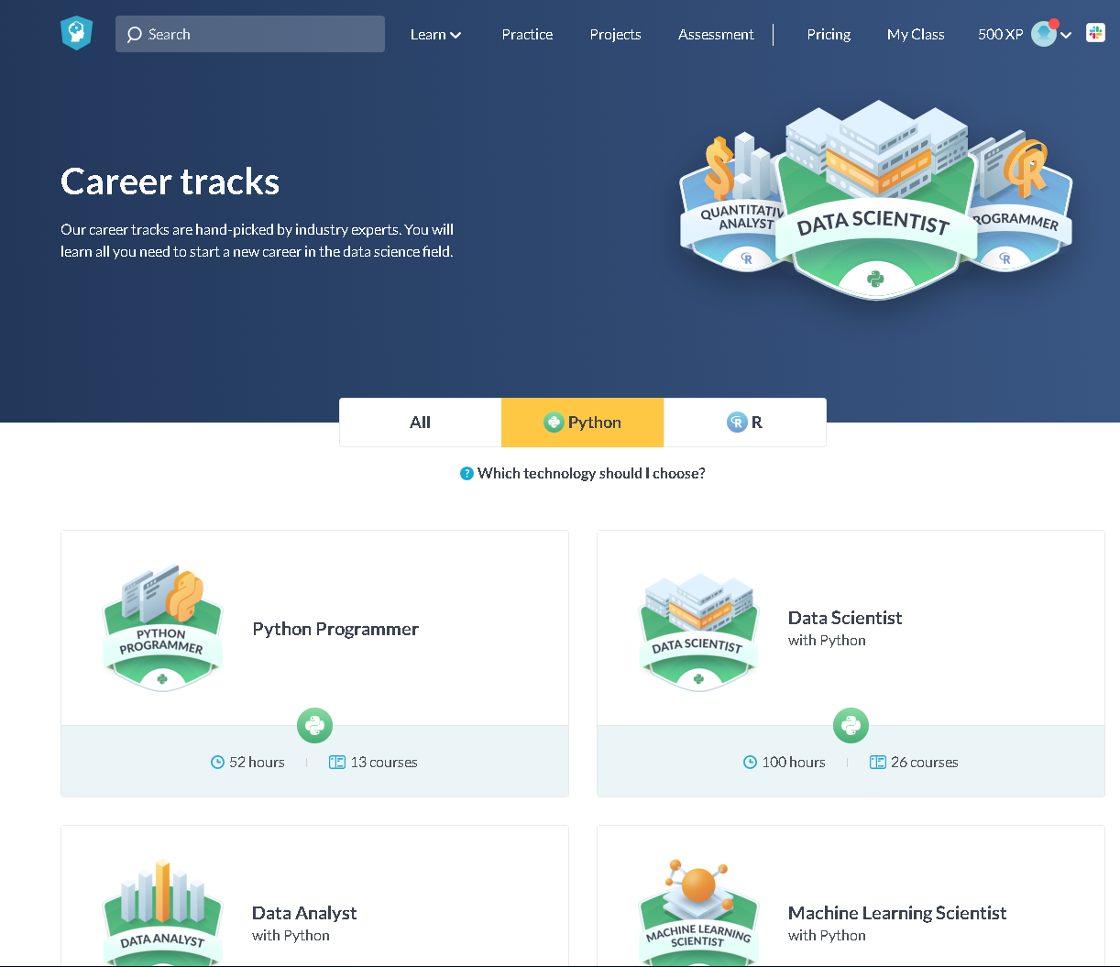
Datacamp
I will assign individual modules that are relevant to the content that we are covering in class.
Datacamp is a great resource that will help you acquire or refresh your Python skills.
You will have free access to the entire Datacamp curriculum during the semester if you want to do more.

Slide 7
What is analytics?
Analytics is a broad term that encompasses the processes, technologies, frameworks and algorithms to extract meaningful insights from data.
Raw data does not have a meaning until it is contextualized and processed into useful information.
Analytics is this process of extracting and creating information from raw data by ﬁltering, processing, categorizing, condensing and contextualizing the data.
This information obtained is then organized and structured to infer knowledge about the system and/or its users, its environment, and its operations and progress towards its objectives, thus making the systems smarter and more efficient.
Chapter 8 - © 2019 Arshdeep Bahga & Vijay Madisetti

Slide 8
Types of analytics
Descriptive Analytics
Descriptive analytics comprises analyzing past data to present it in a summarized form which can be easily interpreted. Descriptive analytics aims to answer - What has happened?
Predictive Analytics
Predictive analytics comprises predicting the occurrence of an event or the likely outcome of an event or forecasting the future values using prediction models. Predictive analytics aims to answer - What is likely to happen? Predictive Analytics is done using predictive models which are trained by existing data. These models learn patterns and trends from the existing data and predict the occurrence of an event or the likely outcome of an event (classiﬁcation models) or forecast numbers (regression models).
Prescriptive Analytics
While predictive analytics uses prediction models to predict the likely outcome of an event, prescriptive analytics uses multiple prediction models to predict various outcomes and the best course of action for each outcome. Prescriptive analytics aims to answer - What can we do to make it happen? Prescriptive Analytics can predict the possible outcomes based on the current choice of actions.
Chapter 8 - © 2019 Arshdeep Bahga & Vijay Madisetti

Slide 9
What is Big Data?
Big data is deﬁned as collections of datasets whose volume, velocity or variety is so large that it is difﬁcult to store, manage, process and analyze the data using traditional databases and data processing tools.
A recent report by DOMO estimates the amount of data generated every minute on popular online platforms. Below are some key pieces of data from the report:
Facebook users share nearly 4.16 million pieces of content
Twitter users send nearly 300,000 tweets
Instagram users like nearly 1.73 million photos
YouTube users upload 300 hours of new video content
Apple users download nearly 51,000 apps
Skype users make nearly 110,000 new calls
Amazon receives 4300 new visitors
Uber passengers take 694 rides
Netﬂix subscribers stream nearly 77,000 hours of video
Chapter 8 - © 2019 Arshdeep Bahga & Vijay Madisetti

Slide 10

Recommendation Systems
Source: http://www.techradar.com/news/television/best-netflix-series-25-great-netflix-tv-shows-1288230

Slide 11
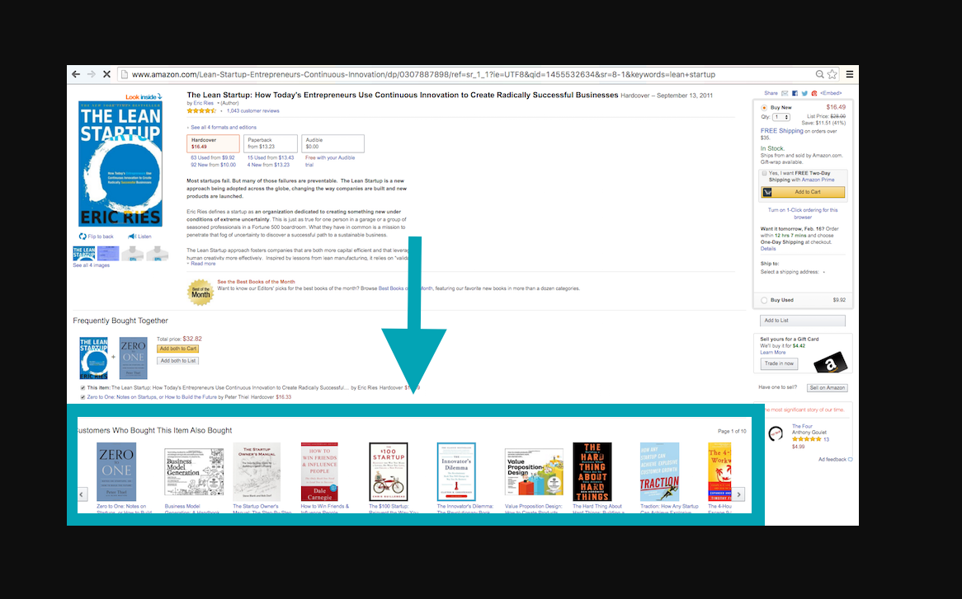
https://www.tastehit.com/blog/how-personalized-recommendations-help-increase-conversion/

Slide 12
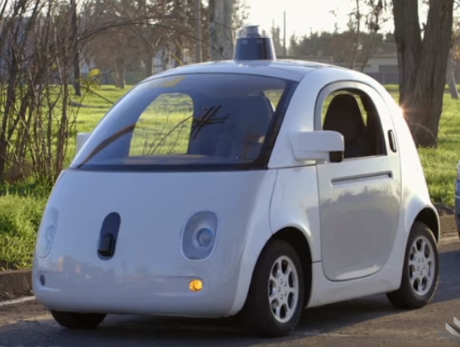

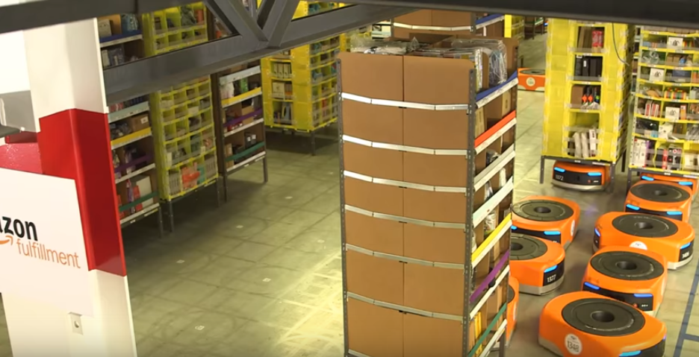
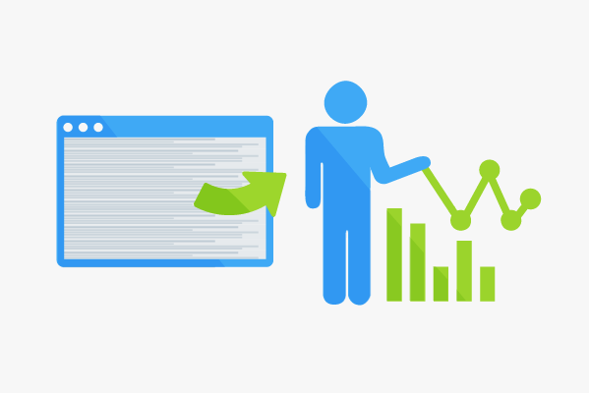

AI in everyday life
Self-driving cars
Amazon Fulfillment
Humanoids
Video link
Log files analysis
Social media analysis

Slide 13
Characteristics of Big Data
Volume
Big data is a form of data whose volume is so large that it would not ﬁt on a single machine therefore specialized tools and frameworks are required to store process and analyze such data.
Velocity
Velocity of data refers to how fast the data is generated. Data generated by certain sources can arrive at very high velocities, for example, social media data or sensor data.
Variety
Variety refers to the forms of the data. Big data comes in different forms such as structured, unstructured or semi-structured, including text data, image, audio, video and sensor data.
Veracity
Veracity refers to how accurate is the data. To extract value from the data, the data needs to be cleaned to remove noise.
Value
Value of data refers to the usefulness of data for the intended purpose. The end goal of any big data analytics system is to extract value from the data.
Chapter 8 - © 2019 Arshdeep Bahga & Vijay Madisetti

Slide 14
Big Data Examples
Data generated by social networks including text, images, audio and video data
Click-stream data generated by web applications such as e-Commerce to analyze user behavior
Machine sensor data collected from sensors embedded in industrial and energy systems for monitoring their health and detecting failures
Healthcare data collected in electronic health record (EHR) systems
Logs generated by web applications
Stock markets data
Transactional data generated by banking and ﬁnancial applications
Chapter 6 - © 2019 Arshdeep Bahga & Vijay Madisetti

Slide 15
Big Data + Analytics = Big Data Analytics
Big data analytics involves several steps starting from data cleansing, data munging (or wrangling), data processing and visualization.
Big Data analytics deals with collection, storage, processing and analysis of this massive-scale data.
Specialized tools and frameworks are required for big data analysis when:
the volume of data involved is so large that it is difﬁcult to store, process and analyze data on a single machine,
the velocity of data is very high and the data needs to be analyzed in real-time,
there is variety of data involved, which can be structured, unstructured or semi-structured, and is collected from multiple data sources,
various types of analytics need to be performed to extract value from the data such as descriptive, predictive and prescriptive analytics.
Chapter 6 - © 2019 Arshdeep Bahga & Vijay Madisetti

Slide 16
OLTP vs. OLAP
Relational databases can be characterized into two categories:
Online Transaction Processing (OLTP)
Online Analytical Processing (OLAP)
OLTP systems are suitable for transaction-oriented applications such as an eCommerce application which require frequently writing new data, updating or deleting existing data, while maintaining the integrity of the data.
OLAP allow the analysis of data for making business decisions. OLAP systems have a lower volume of transactions as compared to OLTP systems; however, the queries are more complex.

Slide 17
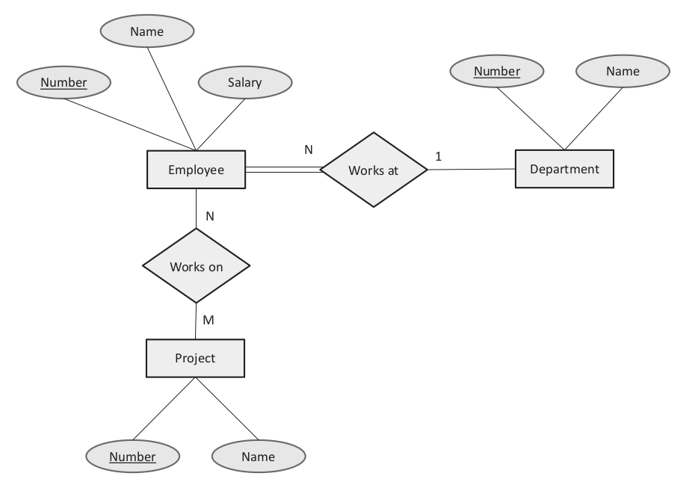
Entity-Relationship (ER) Diagram
Figure shows the Entity-relationship (ER) diagram for the reference application, which graphically represents the entities and their relationships to each other.
The ER diagram shows three entities - Employee, Department, and Project.
A one-to-one relationship exists between Employee and Department entities, whereas a many-to-many relationship exists between Employee and Project.

Slide 18
MySQL
MySQL is an open source Relational Database Management System (RDBMS).
MySQL is one of the most widely used RDBMS and a good choice to be a serving database for data analytics applications where the data is structured.
CREATE TABLE department(
number varchar(50) NOT NULL PRIMARY KEY,
name varchar(200) NULL
);
CREATE TABLE employee (
number varchar(100) NOT NULL PRIMARY KEY,
name varchar(100) NOT NULL,
salary varchar(20) NOT NULL,
department_id varchar(20) REFERENCES department (number),
);
CREATE TABLE project (
number varchar(20) NOT NULL PRIMARY KEY,
name varchar(100) NOT NULL
);
CREATE TABLE workson (
id INT(6) UNSIGNED AUTO_INCREMENT PRIMARY KEY,
employee_id varchar(20) NOT NULL REFERENCES employee (number),
project_id varchar(20) NOT NULL REFERENCES project (number)
);
INSERT INTO department VALUES ("1001", "ECE");
INSERT INTO employee (number, name, salary,department_id) VALUES ("5001",
"Alex", "50000", "1001");
INSERT INTO project VALUES ("201", "Cloud");
INSERT INTO workson(employee_id,project_id) VALUES ("5001", "201");
SQL statements for creating tables
SQL statements for inserting data into tables

Slide 19
SQL Statements for querying data
# Retrieve all employees
SELECT * FROM employee;
# Retrieve top 3 employees with highest salary
SELECT * FROM employee ORDER BY salary DESC LIMIT 3;
# Retrieve all employees in department ’ECE’
SELECT e.name, e.number, d.name FROM employee e, department d WHERE d.name=’ECE’ ;
# Count the number of employees working on ’IoT’ project
SELECT COUNT(*) FROM project p, workson w WHERE p.name=’IoT’ ;

Slide 20
ACID Guarantees
Relational databases provide ACID guarantees.
Atomicity
An atomic transaction ensures that all parts of the transaction complete or the database state is left unchanged.
Consistency
Consistency property ensures that each transaction brings the database from one valid state to another. In other words, the data in a database always conforms to the defined schema and constraints.
Isolation
The transactions are isolated from each other until they finish. This provides concurrency control, i.e. the results of incomplete transactions are not visible to other transactions.
Durability
Durability property ensures that once a transaction is committed, the data remains as it is, i.e. it is not affected by system outages such as power loss. Durability guarantees that the database can keep track of changes and can recover from abnormal terminations.

Slide 21
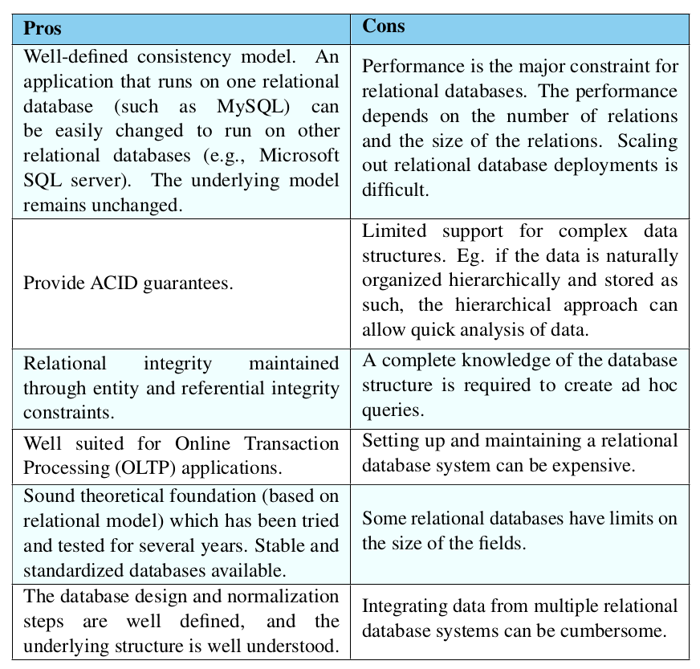
Advantages/Disadvantages of Relational Databases

Slide 22
Next Class
Cloud computing
Introduce TA Ahmed Mustapha
Ahmed Mustapha aomustapha@email.wm.edu
Introduce the lab for Friday
Docker
Cloudera Quickstart VM

